Slide 1

COURSE: CSE299 – JUNIOR DESIGN
Project Proposal
Project Title: yMedia – Video Streaming and Sharing Platform

Slide 2
yMedia – Video Streaming and Sharing Platform
Project Summary:
yMedia is a lightweight video streaming and sharing web platform focused on simplicity, usability, and essential features. The goal is to design a system where users can easily watch, upload, and manage video content without the complexity commonly found in existing platforms.

Slide 3
Supervisor: Mohammad Shifat-E-Rabbi
Our Team
Antara Labiba
Md Yeasin Hossain
Pallab Biswas

Slide 4
Problem Statement:
Proposed Solution:
Many existing video streaming platforms are overloaded with features, dense interfaces, and algorithm-driven content delivery. This often makes them difficult to use for casual viewers and discouraging for new or small content creators.
yMedia proposes a video platform that focuses on core functionality rather than excessive features. The system will allow users to create accounts, upload videos, browse content by category, and interact through basic engagement features.

Slide 5
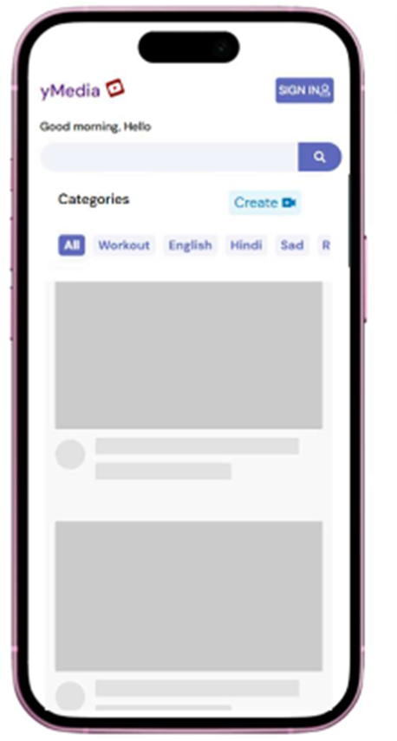
BASIC UI & theme:

Slide 6
Functional Specification
Authentication Module
Content Management
User Interaction
User Interface & Experience
Progressive Web Application Features

Slide 7
Planned Features:
• User registration, login, and profile management
• Video upload, playback, and deletion
• Category-based content browsing
• Likes, comments, and repost functionality
• User settings page for managing uploaded content

Slide 8
Technology Stack:
• Frontend: React.js
• Backend: Node.js with Express.js
• Database: MongoDB
• Video Storage: Firebase Cloud Storage
• Authentication: JSON Web Tokens (JWT)

Slide 9
The End
Thank you for your time and attention.

